Slide 1
Performance requirements for IR magnets
Gijs de Rijk
CERN

Slide 2
Content
IR quad Magnet specification
Acceptance criteria
  LHC lessons
  Upgrade IR quads performance requirements

Slide 3
IT quadrupole preliminary specification (Aug 2010)
Aperture A = 120 mm – 150 mm (t)
Gradient G = 175 T/m – 140 T/m (t)
Cold mass length 8 m – 10 m (t)
Maximum cold mass outer diameter = 600 mm (s)
Operation temperature 1.9 K (option 4.4 K) (t)
Operational current ≤ 13 kA (s)
Angular straightness (tilt) 1 mrad rms
Radiation hardness for (e) (with shielding):
  50 MGy
  2.10¹⁶ protons/cm²
  3.10¹⁸ neutrons/cm²
Maximum heat load
  Local 15 mW/cm³ in 10 cm length parts
  Global 50 W/m
Cold mass pressure tested at 26 bars (NB: t = tbd later, s = soft, e = estimate)

Slide 4
IT quadrupole: acceptance criteria (Aug 2010) as derived from LHC
Acceptance criteria: (what do we call success ?)
  < 3 quenches to reach nominal gradient
    With more a series production will be problemetic
  < 10 quenches to reach 110% of nominal gradient
    We need to aim higher to be sure of the quality of the magnet at nominal
  Maximum 1 quench after thermal cycle to reach nominal gradient
    This is not really well know

Slide 5
Quench performance: look back at LHC dipoles (1)
LHC dipoles reached nominal (87%) within 3 quenches

Slide 6
Quench performance: look back at LHC dipoles (2)
The ultimate was reached within 8 quenches

Slide 7
Quench performance: look back at LHC dipoles (3)
After 1 thermal cycle nominal was reached within 1 quench

Slide 8
HQ: Training quenches
HQ training quenches:
Nominal = 80% ss = 156 T/m
Training Q in % ss
Training Quenches: Gradient
Training Q peak field

Slide 9
HQ: high ramp rate quenches
The LHC quads will ramp around 15 A/s and down ~3x faster. During these ramps magnet are not allowed to quench: For HQ this is for some versions on the limit

Slide 10
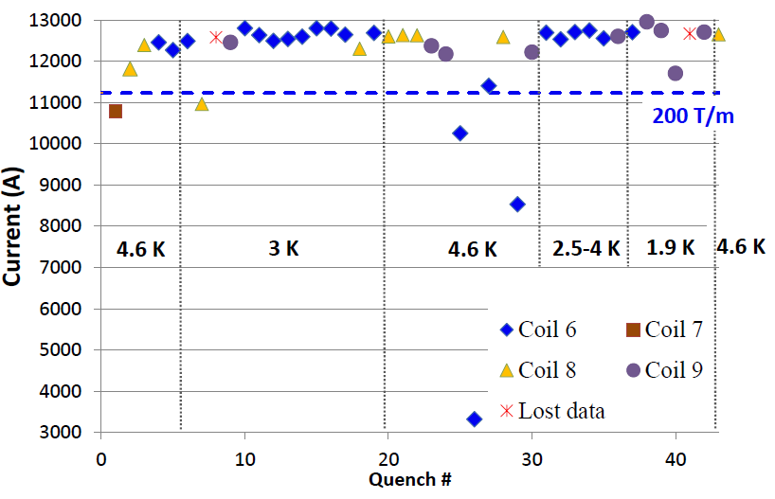
LQS01 Test at Fermilab (see G. Chlachidze’s talk)
LQS01b, a reassembly of LQS01a with more uniform and higher pre-stress, was tested in July 2010
  Reached 222 T/m at 4.6 K
LQS01b quench history

Slide 11
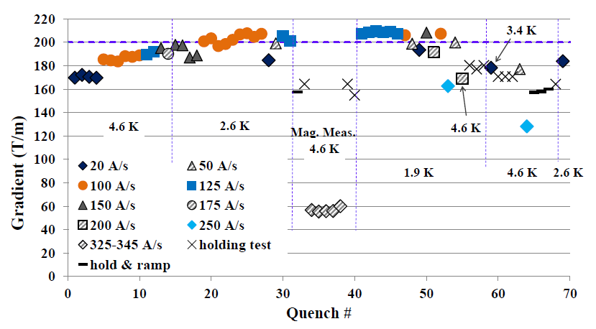
LQS02 Quench History
Exceeded 200 T/m at 1.9 K and 2.6 K (only for ramp rates of 100-150 A/s) but failed to reproduce LQS01b performance

Slide 12
IT quadrupole: acceptance criteria “revisited”
  ≤ 3 quenches to reach nominal gradient => 160 T/m (120 mm)
    The latest HQs show that this should be possible
  < 10 quenches to reach 110% of nominal gradient => 176 T/m
    The latest HQs show that this should be possible
  Maximum 1 quench after thermal cycle to reach nominal gradient
    This is not really well know

