Slide 1
Conceptual Design of the new D1 Magnet for HL-LHC upgrade
Tatsushi Nakamoto (KEK), Qingjin Xu (KEK/CERN)
Ezio Todesco (CERN)
17 Nov. 2011. 1st HiLumi LHC / LARP Collaboration Meeting

Slide 2
Contents
Objective
Guideline of the magnet design
Choice of superconductors
Design with Nb-Ti LHC dipole cable (150 mm aperture)
Design with Nb₃Sn ITER TF strand (150 mm aperture)
Development of Radiation Resistant Organic Materials
Summary

Slide 3
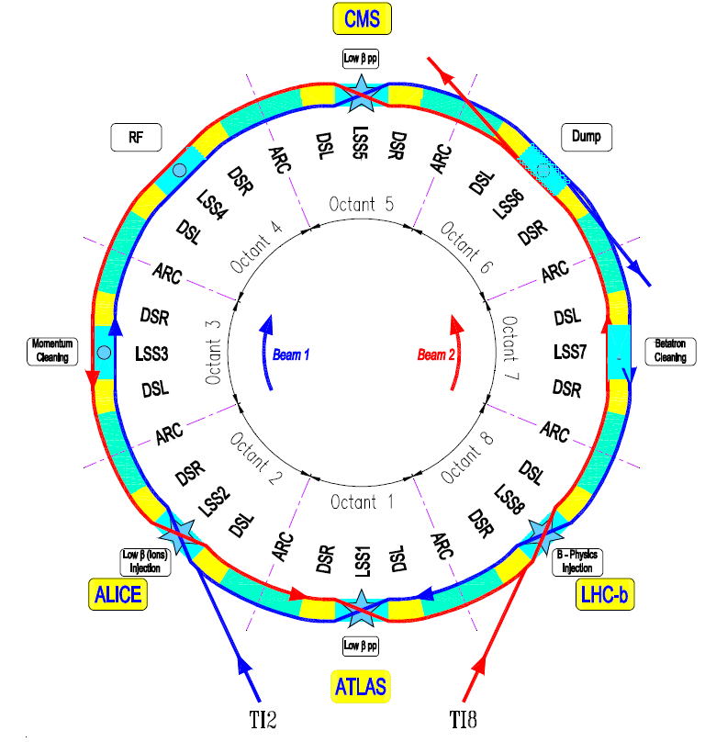
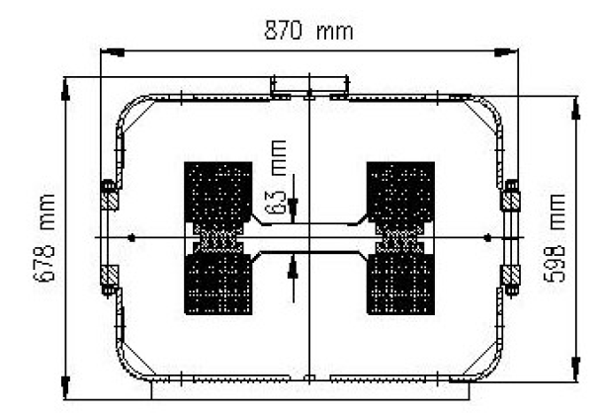
Objective
Towards HL-LHC:
Replace the conventional warm magnet modules D1 (nominal field 1.28T) at IR1 & IR5 by large-aperture radiation hard superconducting magnets.
Schematic layout of the LHC
Current D1 (MBXW) at IR1 & IR5
Current D1 (MBX) at IR2 & IR8
Schematic layout of the right side of IR1 (ATLAS)

Slide 4
Guideline of the new D1 magnet design
Coil ID: 150 mm for the 140 mm triplet
130 mm for the 120 mm triplet
(guess given by R. De Maria)
Integrated field: 40 Tm, 50% larger than today (given by R. De Maria)
Operational margin: 70 % of the loadline (lot of radiation, margin needed)
T_{op}: 1.9 K
Coil lay out: Two layers of 15 mm cable (thick coil to have larger field, lower stress, lower current density)
Conductor: Nb-Ti is baseline, ITER TF Nb₃Sn (Br) also considered.
Field homogeneity: ~ 10⁻⁴ at 2/3 bore radius
Cold mass OD: 570 mm (same as MB)
>> Fringe fields can be an issue.
Radiation, energy deposition "order of 10 MGy, 10²¹ /m², 10 W/m" ??
Choices to be done:
Support structure: Collaring yoke structure, or Shell-based structure.

Slide 5
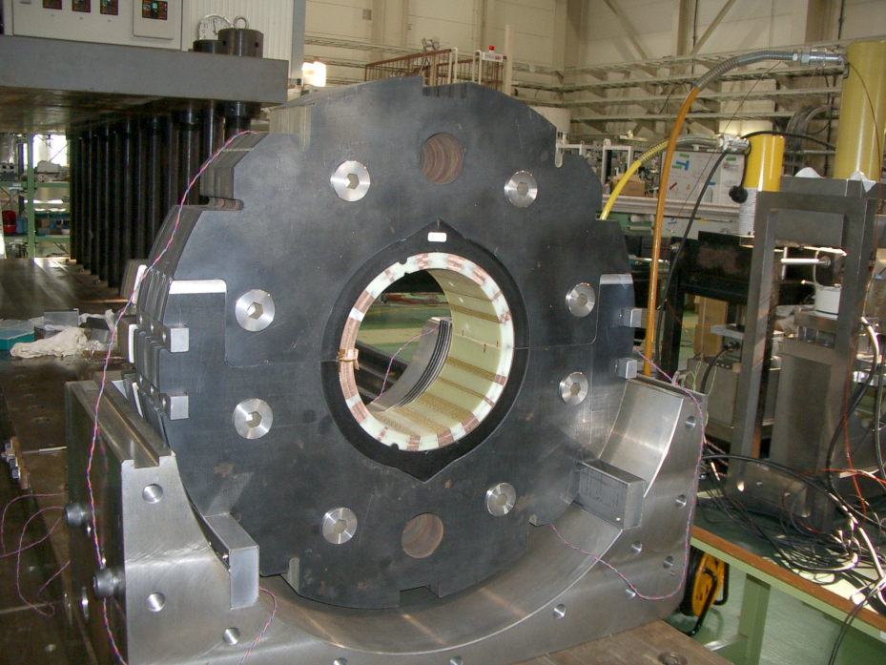
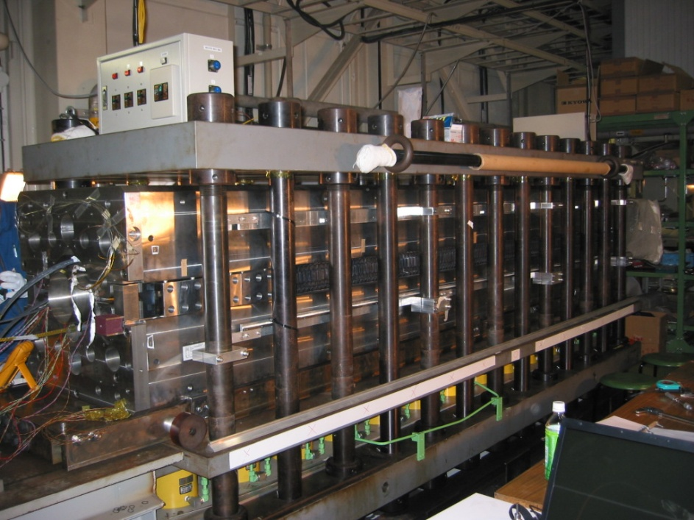
Resource and Constraint
NbTi SC cable for MQXC (leftover of the LHC main dipole cable with new insulation system enhancing cooling capability) is the baseline.
Reuse of tooling, jigs, and facilities of the J-PARC SC Combined Function Magnets.
Yoke OD of 550 mm, same as the LHC main dipole. Yoke inner shape could be modified.
Press jig for collaring-yoke (3.6 m long) can be used as is.
2300 ton hydraulic press

Slide 6
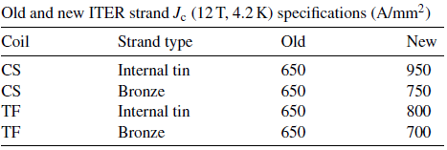
Critical surface of superconductors
*Nb3Al Jc: average results of the sample K1 and K3
1.9 K
4.2 K
RRP Nb₃Sn
Nb₃Al
NbTi
Bronze Nb₃Sn
*[2]
[1] L. Rossi, E. Todesco, "Electromagnetic Design of Superconducting Dipoles Based on Sector Coils", Phys. Rev. STAB, 10 112401 (2007)
[2] D. Ciazynski, “Review of Nb3Sn conductors for ITER”, Fusion Engineering and Design 82 (2007) 488-497

Slide 7
Main field versus coil width: 6.5 T with 30 mm coil and Nb-Ti at 70%
Short sample field [1]
Iron effect
Nb₃Al
ITER Nb₃Sn (Br)
1.9 K
NbTi
4.2 K

Slide 8
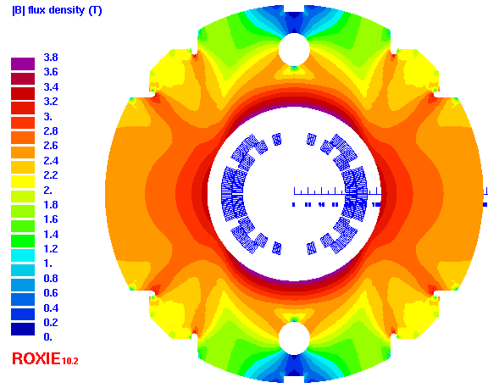
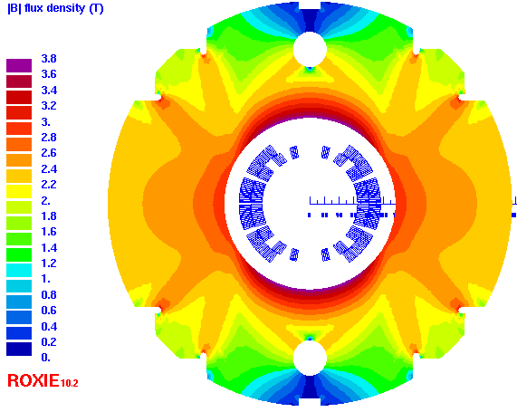
Design with NbTi LHC dipole cable (inner)
Bore diameter 150 mm
Item | Value |  | Ratio
Bore diameter | 150 mm (MBXE) | 130 mm (MBXD) | 1.15
Nominal field (dipole) | 6.35 T | 6.48 T | 0.98
Operating current | 9.3 kA | 9.2 kA | 1.01
Field homogeneity | <0.01% (R_{ref}=50/43 mm) |  | /
Peak field in the coil | 7.06 T | 7.08 T | 0.997
Load line ratio at 1.9 K (Inner / Outer layer) | 70% / 63.7% | 70% / 64.8% | 1
Stray field @ 0.5 m from center | 102 mT | 64 mT | 1.6
Inductance (low/nominal) | 16.1/13.6 mH/m | 12.8/10.6 mH/m | 1.28
Stored energy | 588.1 kJ/m | 448.6 kJ/m | 1.31
Peak field/central field | 1.11 | 1.09 | 1.02
Lorenz force X/Y | 2.1/0.97 MN/m | 1.96/0.86 MN/m | /
Average coil stress in mid plane | 71 MPa | 57 MPa | 1.25
Outer diameter of iron yoke | 550 mm |  | /
Strand diameter | 1.065 |  | /
Supercon. current density | 1000 A/mm² | 989 A/mm² | 1.01
Bore diameter 130 mm

Slide 9
Design with NbTi LHC dipole cable (inner)
Transfer function of the 2 cases with the collar width of 20 mm.
The dependence of b₃ on the operating current caused by iron saturation and filament magnetization.
Bore diameter: 130 mm
Bore diameter 150 mm
Collar thickness 20 mm
Bore diameter 130 mm
Collar thickness 25 mm
Bore diameter 130 mm
Collar thickness 20 mm

Slide 10
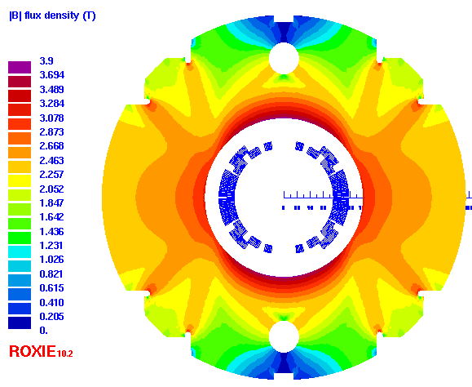
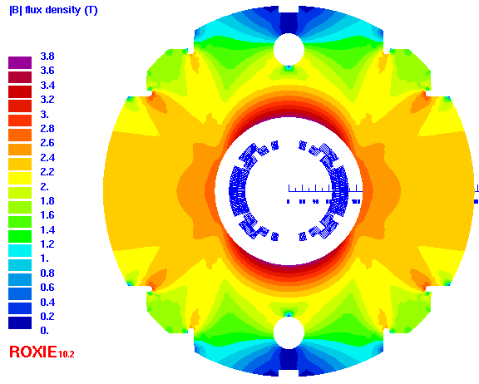
Alternative design with bronze Nb₃Sn ITER TF strand: 6-6.5 T field with 22 mm coil width
Bore diameter 150 mm
Item | Value |  |  | Ratio
Bore diameter | 150 mm (MBXE) |  | 130 mm (MBXD) | 1.15
Nominal field (dipole) | 6.19 T |  | 6.31 T | 0.98
Operating current | 7.1 kA |  | 7.0 kA | 1.01
Field homogeneity | <0.01% (R_{ref}=50/43 mm) |  |  | /
Peak field in the coil | 7.02 T |  | 7.04 T | 0.997
Load line ratio at 1.9 K (Inner / Outer layer) | 70.4% / 64.5% |  | 70.1% / 64.8% | 1
Stray field @ 0.5 m from center | 76 mT |  | 40 mT | 1.9
Inductance (low/nominal) | 23.1 / 20.1 mH/m |  | 18.0 / 16.3 mH/m | 1.23
Stored energy | 507 kJ/m |  | 399 kJ/m | 1.27
Peak field/central field | 1.13 |  | 1.12 | 1.01
Lorenz force X/Y | 1.92/0.87 MN/m |  | 1.78/0.77 MN/m | /
Average coil stress in mid plane | 103 MPa |  | 86 MPa | 1.2
Outer dia. of iron yoke | 550 mm |  |  | /
Strand diameter | 0.82 |  |  | /
Cu/Non-Cu ratio | 0.97 |  |  | /
Cable dimension / insulation | 11.0* 1.48mm² / 0.15 mm (radial) 0.15 mm (azimuthal) |  |  | /
No. of strands | 26 |  |  | /
Keystone angle | 1.2 ° |  |  | /
Supercon. current density | 1033 A/mm² | 1018 A/mm² |  | 1.01
Bore diameter 130 mm

Slide 11
Design with bronze Nb₃Sn ITER TF strand & cable
Transfer function of the 2 cases with the collar width of 20 mm.
The dependence of b₃ on the operating current caused by iron saturation and filament magnetization.
Bore diameter
130 mm
Bore diameter: 130 mm Collar thickness 27 mm
Bore diameter 130 mm Collar thickness 20 mm

Slide 12
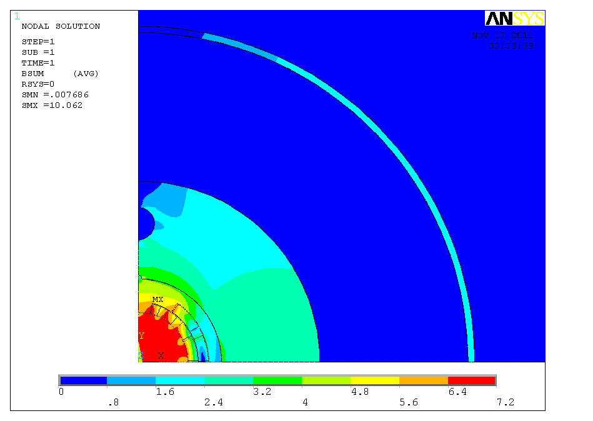
Stray field of the magnet
0.1T @ surface of Cryostat (iron, 10mm)
Stray field will be issues of environment.
Magnetic force between the cold mass and the iron cryostat must be considered. Off-centered cold mass position in the current MB cryostat would not be allowed.

Slide 13
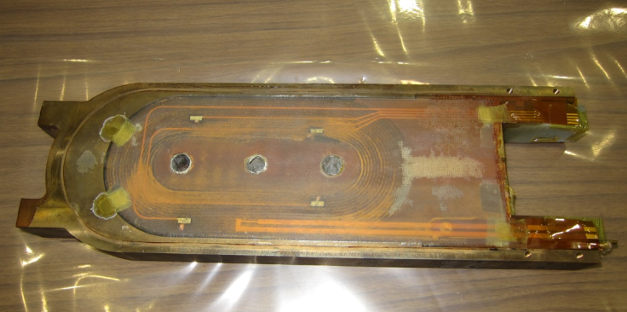
Development of Radiation Resistant Organic Materials
Epoxy may not be used…
New Cyanate Ester base resin for accelerator HFM application (LHC upgrade)
60 Cyanate Ester / 40 Epoxy
low viscosity, low reaction temperature < 150 °C
pot life: 24hr@ 60 °C, < 20 cP
Development of insulation coating technologies on metallic parts (i.e. end spacers, wedges)
Ceramic spray
Polyimide coating by Vapor Deposition Polymerization technology.
Materials development using BT (Bismale-imide Triazine) resin and Cyanate Ester/Epoxy resin. (Planned)
Pre-pregnant tape (curing at 150 °C)
GFRP

Slide 14
Summary
70% operational field on the load line gives the nominal of about 6-6.5 T.
Coil width of 30 mm (22 mm for Nb3Sn) to reduce stress and lower current density.
Stress due to Lorentz forces 50-70 MPa for Nb-Ti option, around 100 MPa for Nb₃Sn
Large fringe field can be an issue. Survey the influence to the environment.
Good field quality will be only required at the beam collision. Study the strong saturation effects of the iron yoke and accordingly modify its inner shape.
Nb₃Sn design with low-j ITER strand provides similar field as in Nb-Ti, but 2-3 times larger temperature margin.
Further conceptual design in terms of 3D field, mechanical, thermal analysis will be made.

Slide 15
Acknowledgement
This work is carried out both at the Cryogenics Science Center of KEK and TE-MSC group of CERN. We would like to thank all the colleagues in these two groups, for their kind support of this R&D work.
Special thanks go to T. Taylor, G. De Rijk, and A. Milanese (CERN) for their helpful comments and B. Auchmann (CERN) for his kind support on the ROXIE software.

